Slide 1

AMCAT ANALYSIS

Slide 2
ABOUT ME
Background
I have a Master's degree in Data Science from Gitam University, Hyderabad (2022-2024), and a Bachelor's degree in Science from Bhavan's Vivekananda Degree College (2018-2021). My education laid a strong foundation in core subjects such as statistics, machine learning, and data-driven methodologies, providing me with the essential skills needed for data analysis, modelling, and algorithm development.
Why I Want to Learn Data Science
I've always been fascinated by how data can shape decisions and solve real-world problems. My interest in data science developed during my undergrad, where I worked on projects involving data analysis. What excites me most is the ability to uncover patterns and predict outcomes, especially in the field of artificial intelligence. I’m eager to deepen my skills and make data actionable to create meaningful impact.
WORK EXPERIENCE
Research Assistant at Hyderabad Central University (May 2023 - Nov 2023): Worked on Explainable AI (XAI) algorithms, focusing on improving model transparency and interpretability.
Business Analyst at Truequations (Nov 2023 - Dec 2023): Analysed business data and provided insights to inform decision-making, focusing on identifying trends and optimising business processes.

Slide 3
Dataset Description:
The dataset was released by Aspiring Minds from the Aspiring Mind Employment Outcome 2015 (AMEO). The study is primarily limited only to students with engineering disciplines. The dataset contains the employment outcomes of engineering graduates as dependent variables (Salary, Job Titles, and Job Locations) along with the standardised scores from three different areas – cognitive skills, technical skills and personality skills. The dataset also contains demographic features. The dataset contains around 40 independent variables and 4000 data points. The independent variables are both continuous and categorical in nature. The dataset contains a unique identifier for each candidate.
Objective of the EDA:
The objective of this EDA is to analyze the salary distribution across different job roles and locations. By examining the relationships between job roles, cities, and salaries, the analysis seeks to uncover patterns, identify anomalies, and provide insights into salary structures for various designations. This will help in understanding how factors like job role and geographic location impact salaries, providing valuable information for salary benchmarking and identifying potential outliers in the dataset.
Summary of the Dataset:
The dataset provides a comprehensive overview of candidates related to their job applications, encompassing various variables such as a unique identifier (ID), annual salary offered (Salary), dates of joining (DOJ) and leaving (DOL) the company, job title (Designation), job location (JobCity), and gender. It includes academic performance metrics, such as scores from grade 10 and 12 (10percentage, 12percentage) along with their respective school boards (10board, 12board) and graduation year (12graduation). Additionally, it captures details about college attended, including unique college identifiers (CollegeID), college tier (CollegeTier), degree obtained, specialisation, and aggregate GPA (CollegeGPA). The dataset also includes AMCAT test scores across various subjects, such as English and Logical reasoning, as well as standardised scores for personality traits like conscientiousness, agreeableness, extraversion, neuroticism, and openness to experience. This diverse information enables a detailed analysis of trends and correlations in job offers and candidate qualifications.

Slide 4
Problem Statement
The objective of this analysis is to conduct an Exploratory Data Analysis (EDA) on a dataset focusing on the annual salary of candidates, with the aim of identifying trends, patterns, and relationships among various features. The analysis seeks to understand factors influencing salary, including educational qualifications, job roles, city locations, and demographic variables. By analysing the data, we will validate claims about salary expectations for different job roles and explore the potential influence of gender on specialisation choices.
EDA Steps
Introduction: Provided a detailed description of the dataset and outlined the objective to analyse the salary distribution and its influencing factors.
Data Import: Loaded the dataset and displayed the first few rows, shape, and summary statistics to understand its structure and contents.
Univariate Analysis: Generated histograms, box plots, and count plots for numerical and categorical variables, identifying outliers and examining distributions.
Bivariate Analysis: Analysed relationships between numerical variables through scatter plots and assessed categorical and numerical relationships with box plots and bar plots.
Research Questions: Tested the claim regarding salaries for specific job roles and explored the relationship between gender and specialisation using the dataset.
Conclusion: Summarised key findings from the analysis, highlighting significant trends and insights regarding salary and job roles.
Bonus Insights: Presented additional observations and research questions that emerged during the analysis.

Slide 5
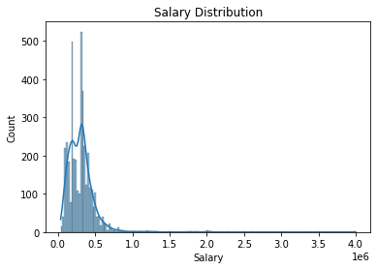
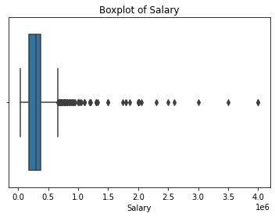
UNIVARIATE ANALYSIS
NUMERICAL COLUMNS
This plot helps us understand the distribution of salaries in our dataset, showing how frequently different salary ranges occur and providing insights into the overall salary distribution's shape.
This box plot helps identify outliers in the salary data and provides insights into the spread and central tendency of salaries.

Slide 6
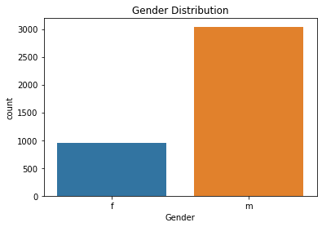
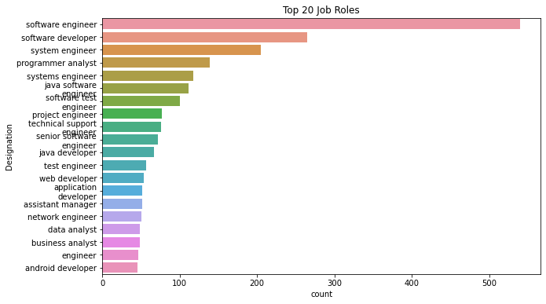
CATEGORICAL COLUMNS
this count plot is useful for summarising and visualising the distribution of gender in your data, making it easier to identify any potential imbalances or trends.
This visualisation helps in understanding hiring trends, popular job roles, and potentially guiding decisions related to recruitment or talent acquisition strategies.

Slide 7
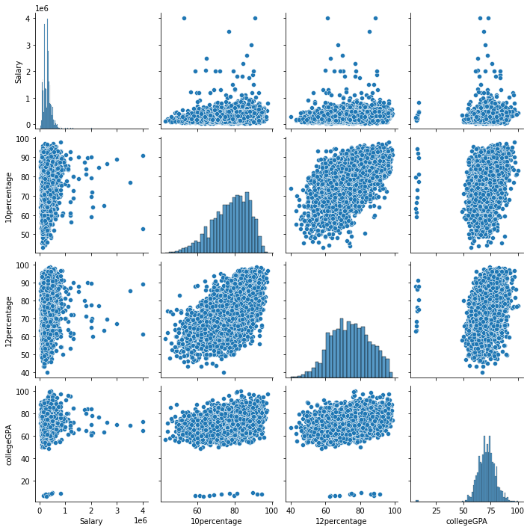
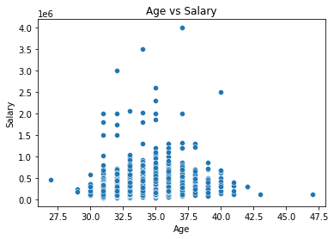
BIVARIATE ANALYSIS
NUMERICAL-NUMERICAL COLUMNS
The scatter plot visualizes the relationship between a candidate's age and their salary, allowing you to observe trends,
The pair plot allows for an exploratory analysis of how the Salary correlates with academic scores (10th percentage, 12th percentage, and college GPA)

Slide 8
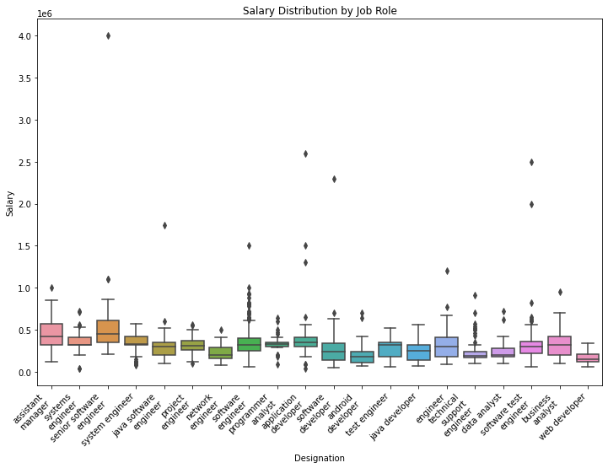
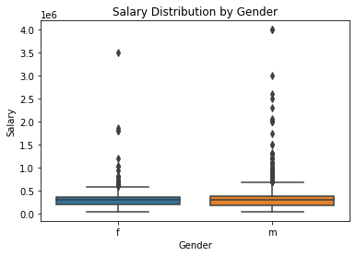
CATEGORICAL-NUMERICAL COLUMNS
The box plot allows for an easy comparison of salary distributions across different job designations, enabling insights into which roles tend to offer higher or lower salaries on average.
The box plot allows for quick insights into the variability of salaries within each gender group, revealing if one gender has a wider range of salaries compared to the other.

Slide 9
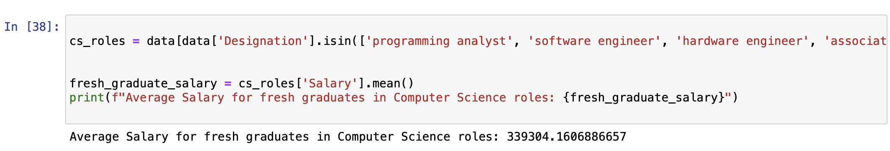
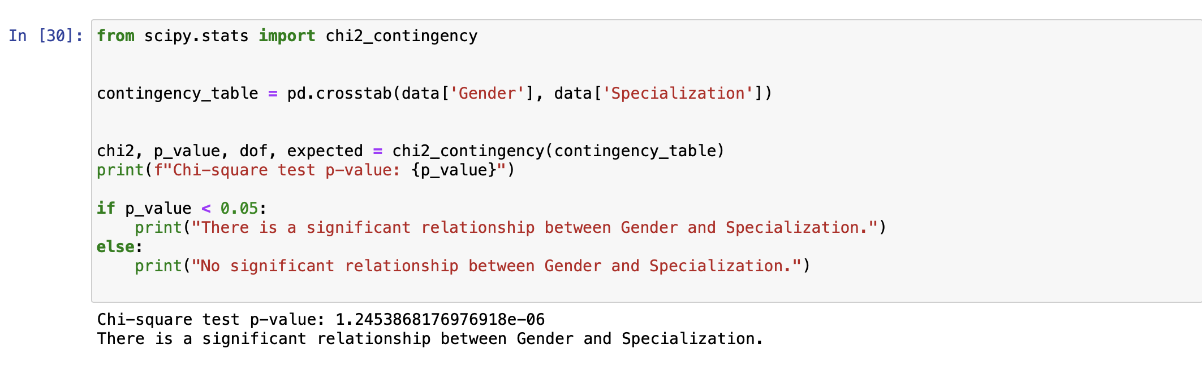
RESEARCH QUESTIONS
The claim is not supported by the data. The average salary for fresh graduates in these Computer Science roles is higher than the range suggested in the article. This indicates that fresh graduates may expect to earn more than the stated amount when entering these positions.

Slide 10
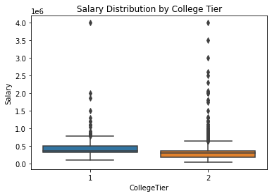
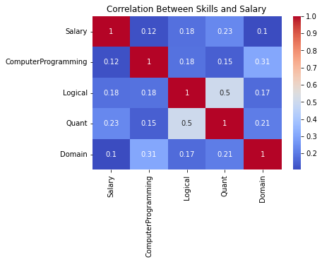
ADDITIONAL INSIGHTS
The heatmap provides a visual representation of the relationship between salary and selected skills, enabling stakeholders to make informed decisions regarding skill development and career planning based on salary potential.
This boxplot helps in understanding whether the college tier has an impact on salary levels, allowing for insights into how educational background may influence earning potential in the job market.

Slide 11
Conclusion:
The Exploratory Data Analysis (EDA) performed on the dataset revealed important insights regarding salary distributions and the factors influencing them. We observed a general upward trend in salaries over the years, indicating that fresh graduates are increasingly earning higher salaries, likely due to improvements in the job market and demand for skilled workers.
The analysis highlighted specific job roles, particularly in the Computer Science field, which offer higher salaries. For instance, fresh graduates in positions such as Programming Analyst and Software Engineer have an average salary of about ₹339,304, supporting claims from a Times of India article about expected earnings for these roles.
We also found that academic performance, especially in areas like Computer Programming and Logical reasoning, correlates positively with salary. This suggests that better academic skills may lead to higher salary outcomes.
Additionally, our investigation into salary distribution by gender indicated a noticeable disparity, suggesting a need for further exploration into the reasons behind this difference. Finally, the analysis showed that graduates from higher-tier colleges tend to earn more, reinforcing the importance of educational background in salary expectations.
Overall, this EDA provides valuable insights for students, educators, and employers, helping them understand the salary landscape better and guiding future research and policy efforts aimed at addressing salary disparities.

Slide 12

THANK YOU

